Slide 1
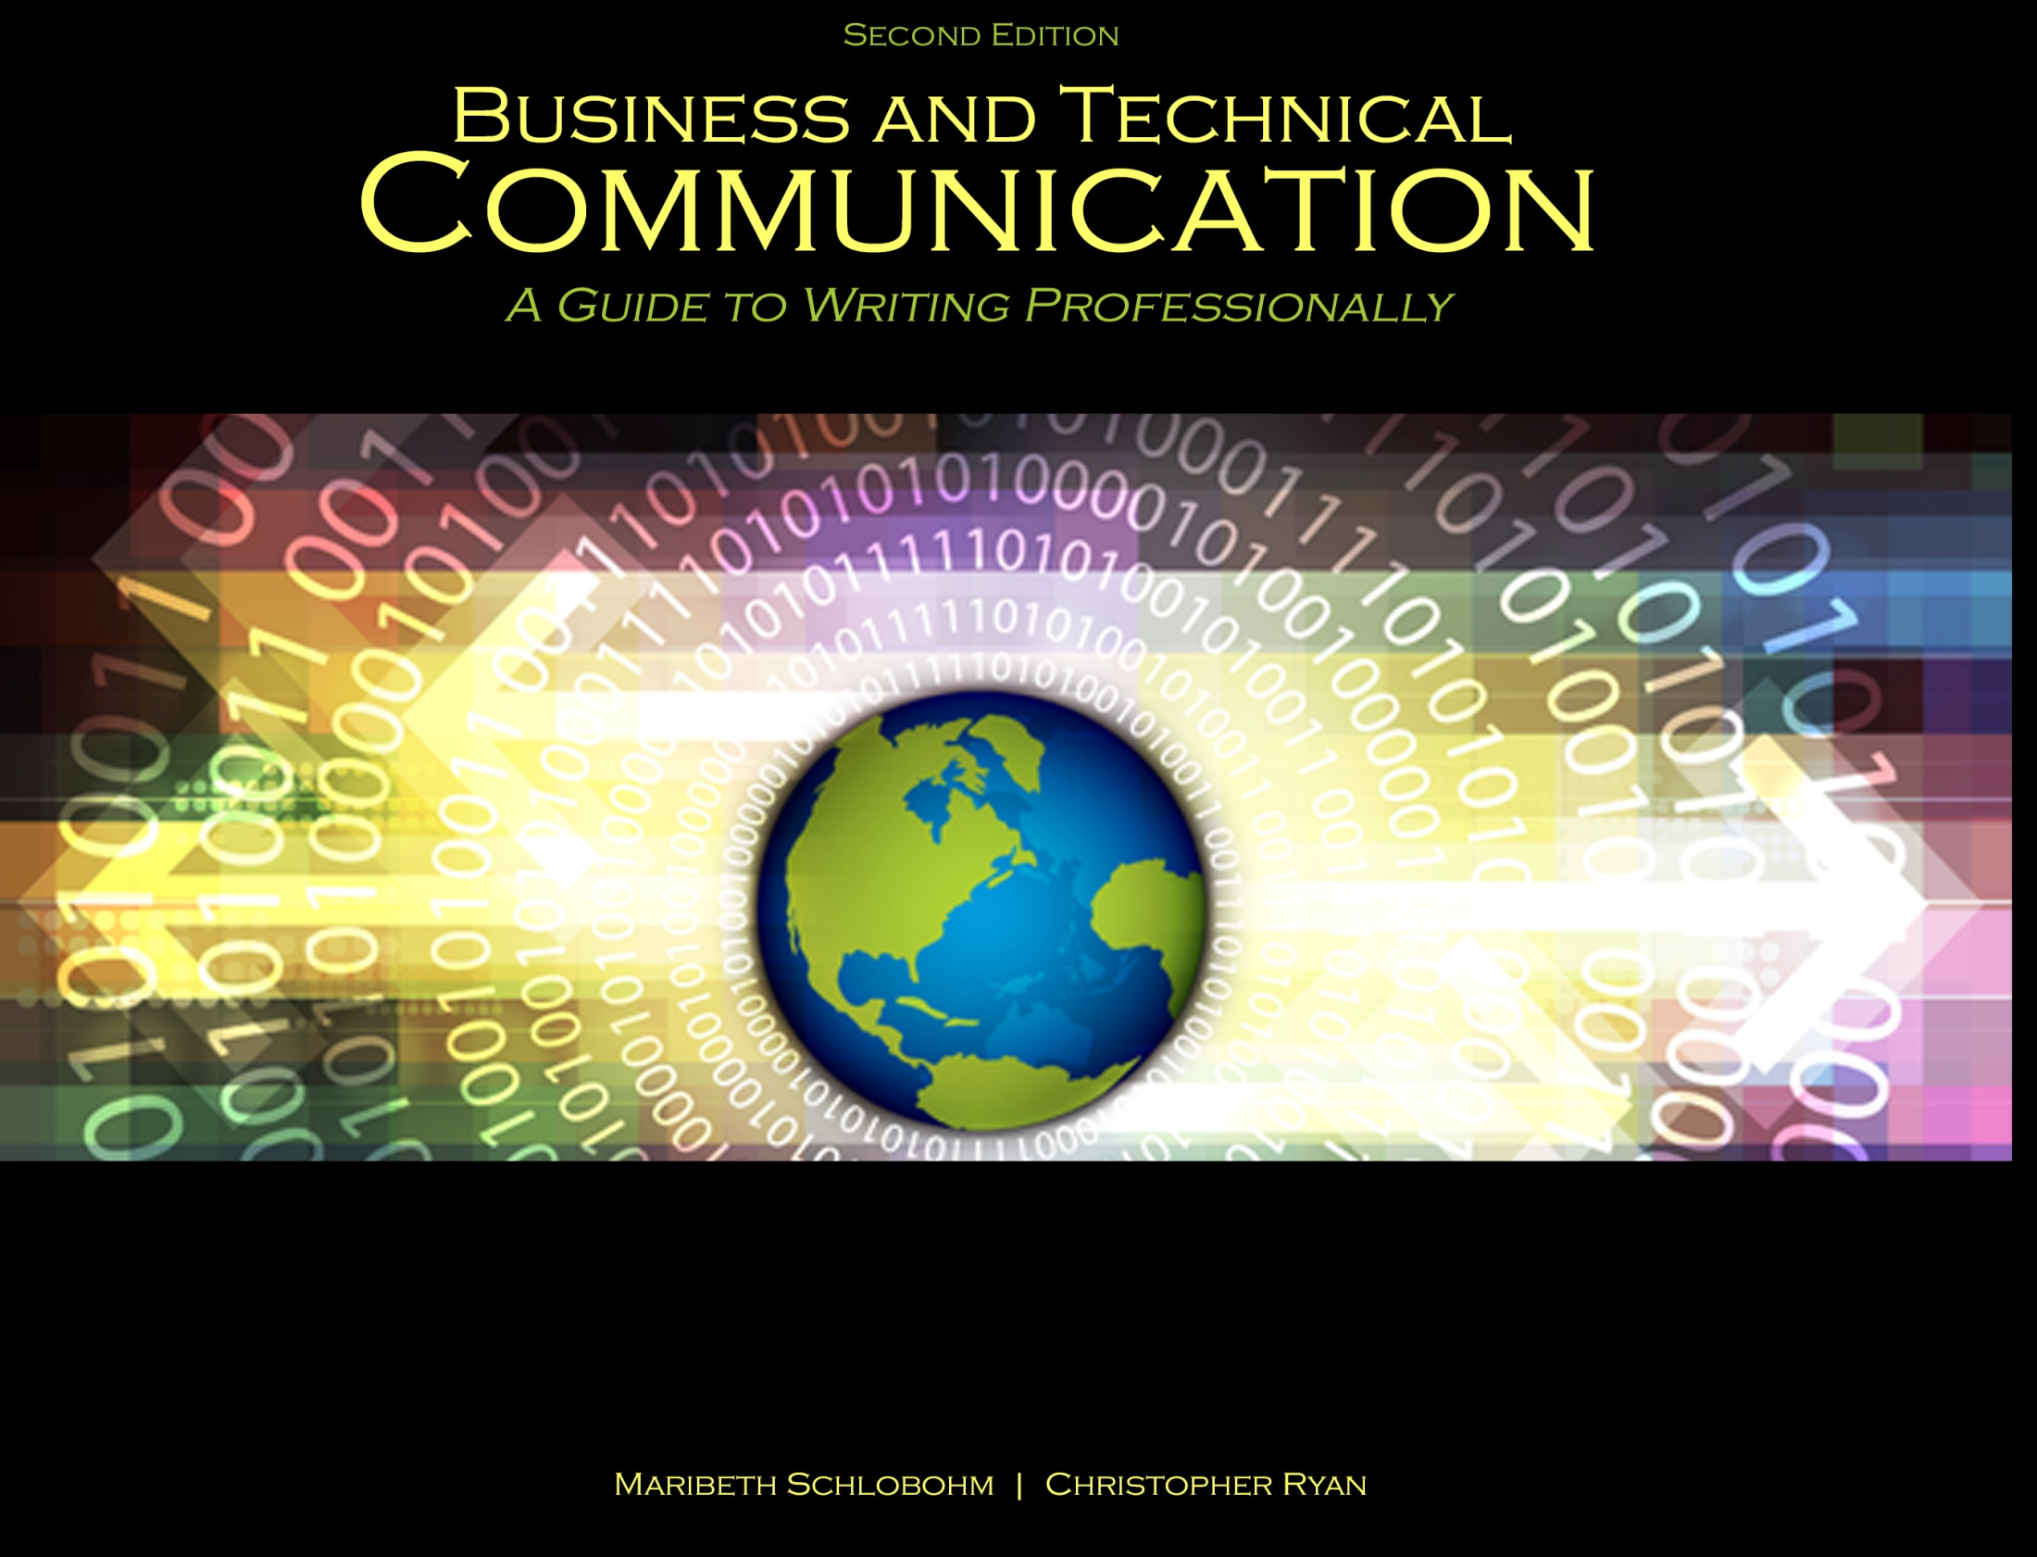
Chapter 9: Gaining, Retaining, and Advancing Employment

Slide 2


Job Search Process
Finding opportunities
Searching job postings
Connecting with employers
Networking
Using school career centers

Slide 3

Important Considerations
Sanitizing social media accounts
Being aware of background checks and the law
Being ethical

Slide 4
The Hiring Process
Resume writing and processing
Key word searches
Tailoring your resume
Applying honesty

Slide 5

Writing and Designing the Resume
SECTIONS:
Name and contact information
Objective/Summary
Education
Employment
Involvement
Personal
References

Slide 6
Cover Letter
Demonstrate familiarity with company
Highlight compelling aspects not necessarily contained in resume
Show good will toward reader

Slide 7
Interviewing
METHODS:
Phone interviews
Face-to-face interviews
Technologically aided interviews

Slide 8
Interviewing Follow-up
Follow-up Letters:
Send within 24 hours
Write no more than one page:
- First paragraph to express gratitude
- Middle paragraph(s) to reinforce your candidacy
- Last paragraph to restate interest and provide hopeful closing

Slide 9
References
Schlobohm, Maribeth and Christopher Ryan. Business and Technical Communication: A Guide to Writing Professionally, 2nd Ed., Dubuque, IA: Kendall-Hunt, 2014. Print.
Shutterstock. “Job concept,” Image ID: 129405980; “Set of social media buttons for design – vector icons,” Image ID: 116391598; Filling resume on wooden table, close-up,” Image ID: 126974384.

Slide 10
Contact Information
Kendall-Hunt Publishing Company
4050 Westmark Drive
Dubuque, IA 52004-1840
http://www.kendallhunt.com
Toll Free: 800-228-0810

